Slide 1
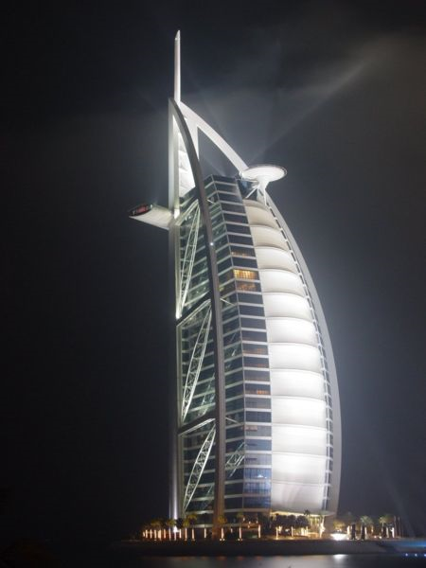
STANE Hotel: Hotel Simulation
Created, submitted, and produced by:
Dane Morgan
Stacy Reddick

Slide 2
Goals and Objectives
Creating a hotel simulation with detailed objects in Autodesk 3dsmax 2008;
Implementing efficient functionalities in VRML; and
Providing a realistic user interaction to the simulation.

Slide 3
STANE Hotel
Established in March 2009
Named after its creators, Stacy and Dane!
Model is actually an actual hotel in Dubai, UAE, called the Burj Al Arab.
Location: A discrete island in between South Carolina and Jamaica.

Slide 4
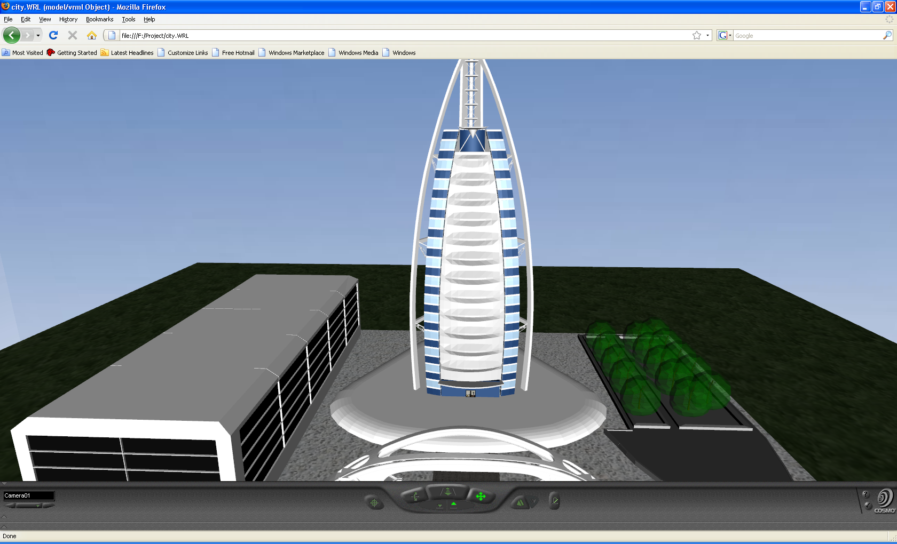

Slide 5
Lobby
Consists of chairs, tables, a television, and a clerk’s desk.
It will also contain an area where the person can use the elevator.
Plants will be around perimeter to give the area a ‘real’ feel.
Views of the outside will also be available to the person.

Slide 6
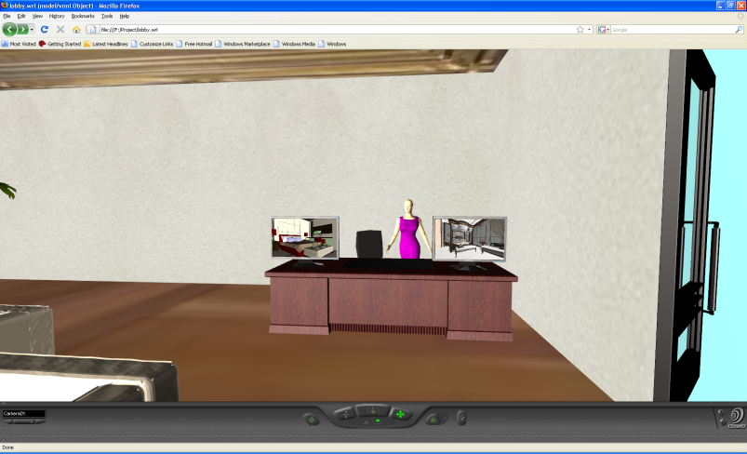
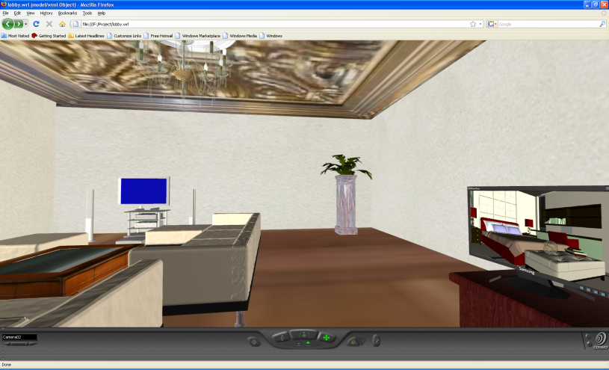
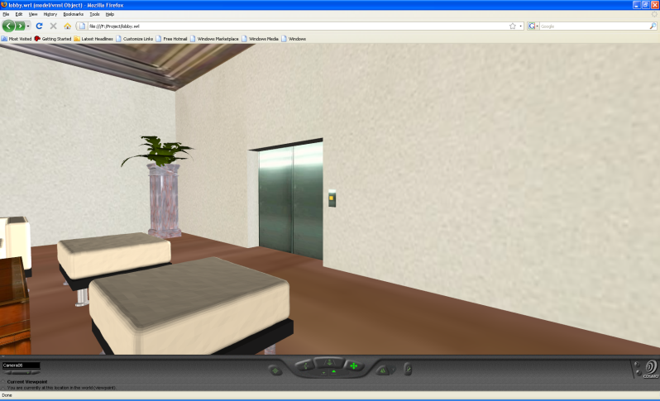
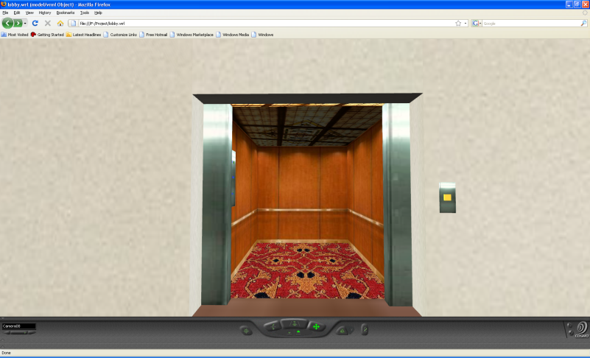

Slide 7
Rooms
Two types of rooms: Luxurious and moderate.
Luxurious
User can choose this elegant room that contains everything you imagine. From a beautiful bed to an entertainment area.
Moderate
User also can choose this decent room that contains just enough to keep you comfortable.

Slide 8
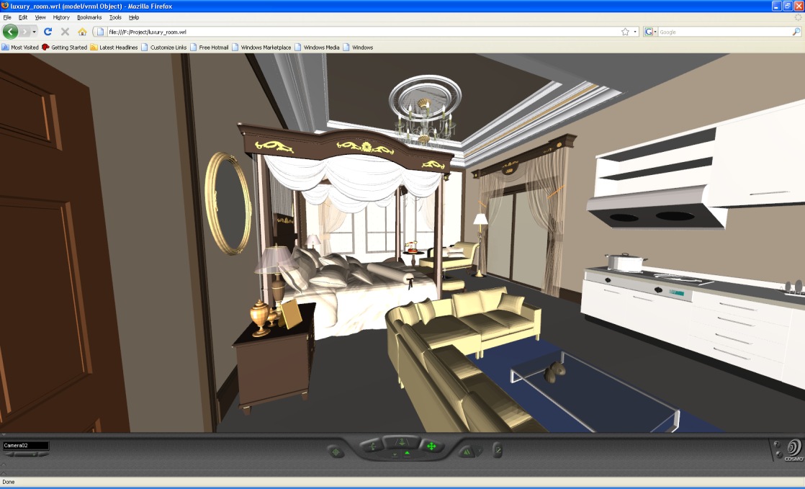
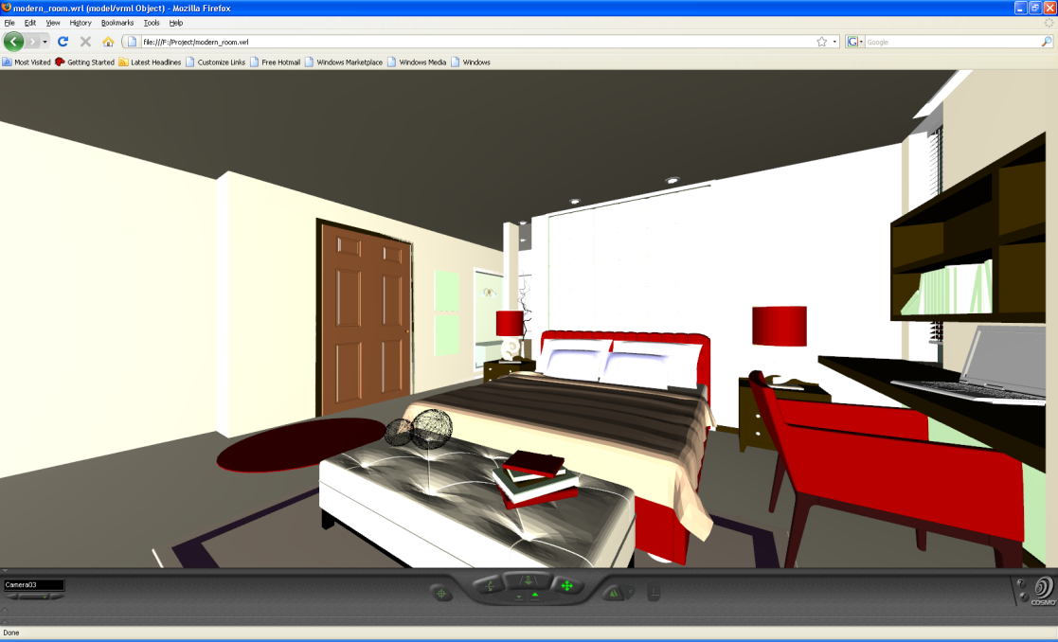

Slide 9
Functions, sensors, lights, etc.
Omni Light
To provide light to the elevator, hallways, and other narrow areas of the hotel.
Tough Sensor
To access the entrance of the hotel.
To access the elevator door.
Anchor Node
To change to different locations of the hotel.
Target Camera
To provide the simulation with a user perspective.
Time Frame
To animate the entrance and elevator doors.

Slide 10
Why Virtual Reality?
Virtual Reality was appropriate for this project simulation because it would increase a hotel’s marketing values by providing customers realistic views and experiences of its various amenities.

Slide 11
Complications
Exportation of .max files to .vrl files
Time

Slide 12
Acknowledgements
Bowie State University Computer Science Department
Dr. Sharad Sharma
Students of COSC 729

